Slide 1

Natalie Ha, Yue Lan, Jingjue Wang, Chengcheng Xu
Ads Click-Through-Rate prediction
using
machine learning
and
distributed computing
Group GameOfSpark

Slide 2
data
Basic Overview:
Data source: https://www.kaggle.com/c/avazu-ctr-prediction/data
10 days of click-through data.
23 features, 1 label (clicked: yes or no)
Why choose this data:
Solves business problem: essential for sponsored search and real-time bidding
Large dataset (~6G): better to run on clusters
Data processing and analytics goal:
Predict whether a mobile ad will be clicked

Slide 3
Data process flow
Store data at AWS S3
Import data into MongoDB on EC2/EMR instances
Load data from MongoDB as RDD/DataFrame
Perform EDA with SparkSQL
Preprocess and feature engineer
Fit models with SparkML
Prediction & Evaluation

Slide 4
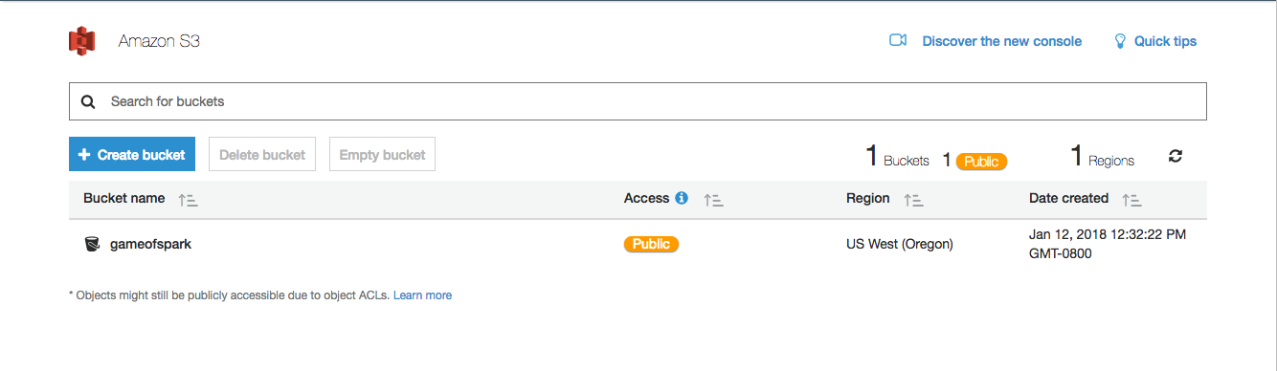
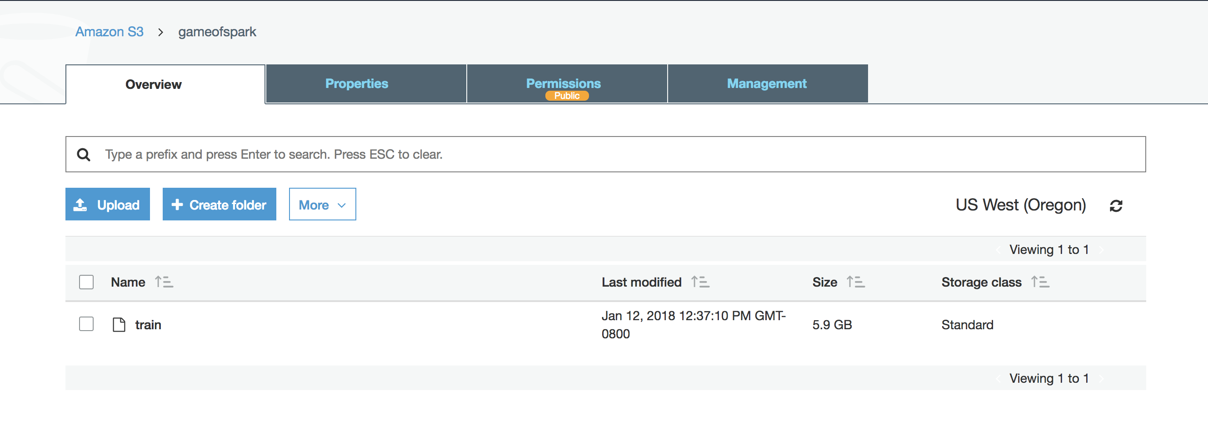
Data storage

Slide 5
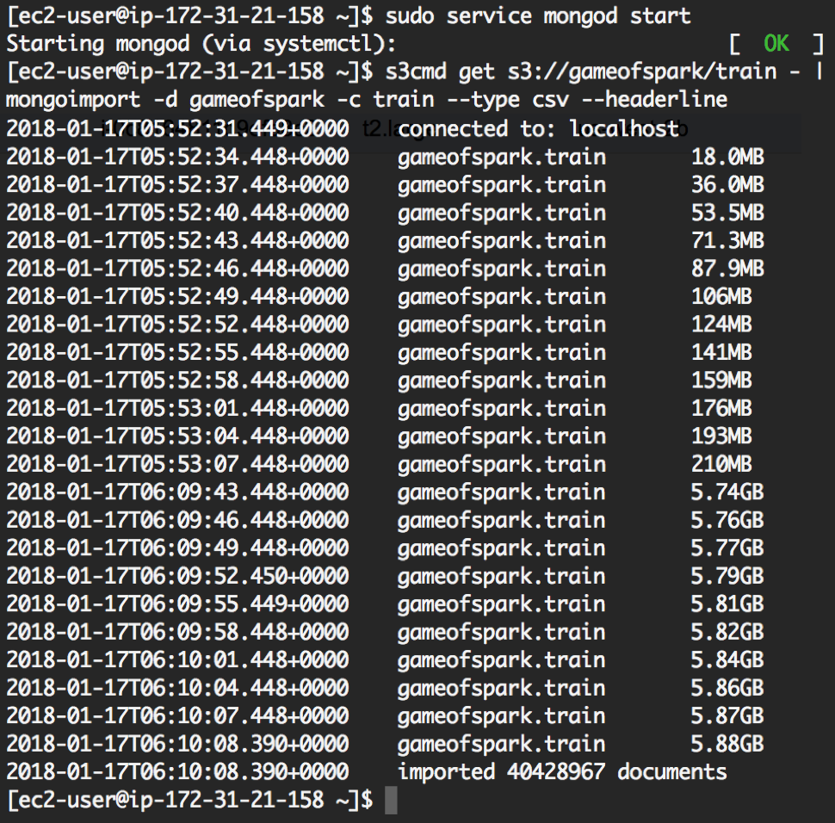
Dbms – mongo db
Import data from S3 into MongoDB on EC2

Slide 6
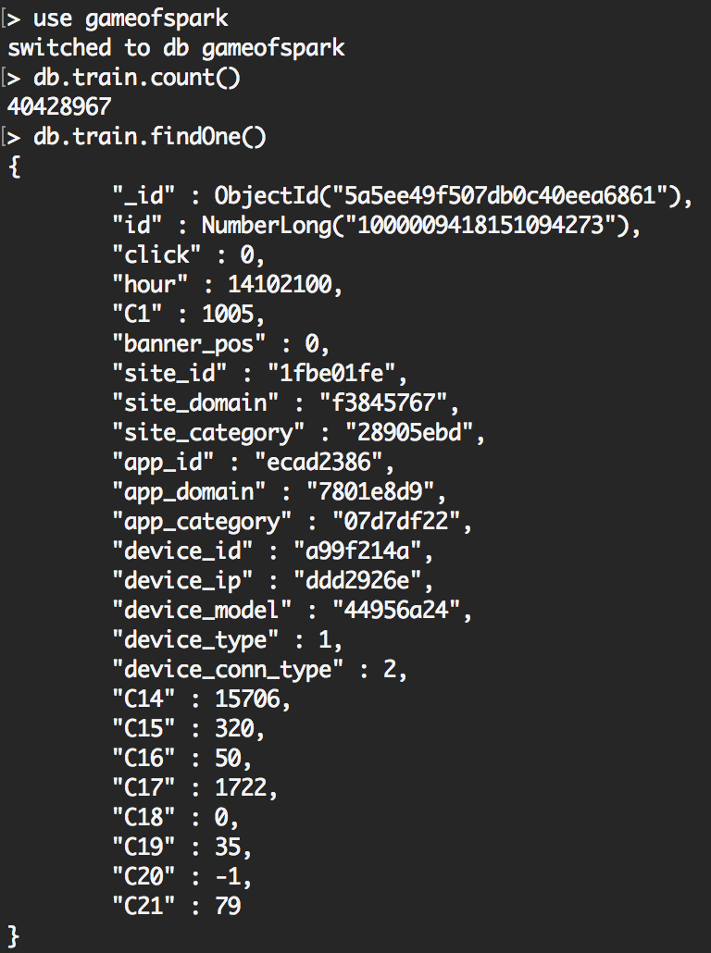
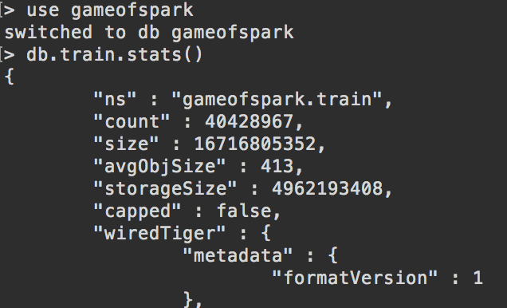
Dbms – mongo db
Query data in Mongo shell
Documents and stats →
Collection stats ↓
Notes:
- Collection stat: #of rows in collection, storage size (how large data is in MongoDB, 5.9GB -> 4.6GB, about 78% compression rate)
- count: number of documents

Slide 7
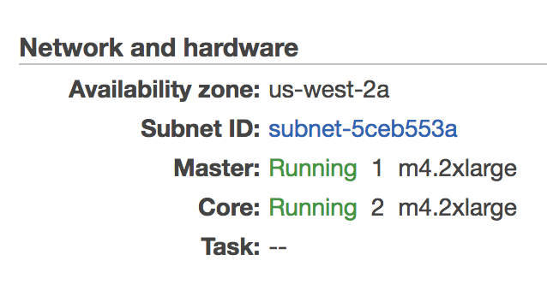
Set up AWS EC2/EMR
EC2: 1 instance, t2.xlarge: vCPU:4, Mem(GiB): 16
EMR: 3 instances, m4.2xlarge: vCPU: 8, Mem(GiB): 32

Slide 8
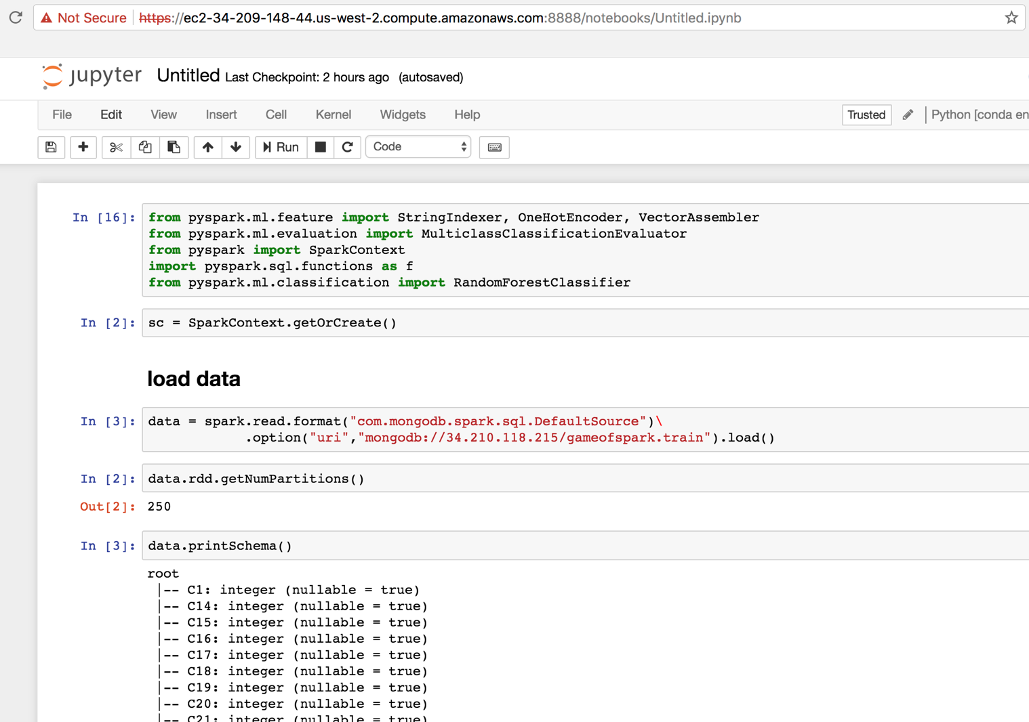
Create DataFrame on EMR

Slide 9
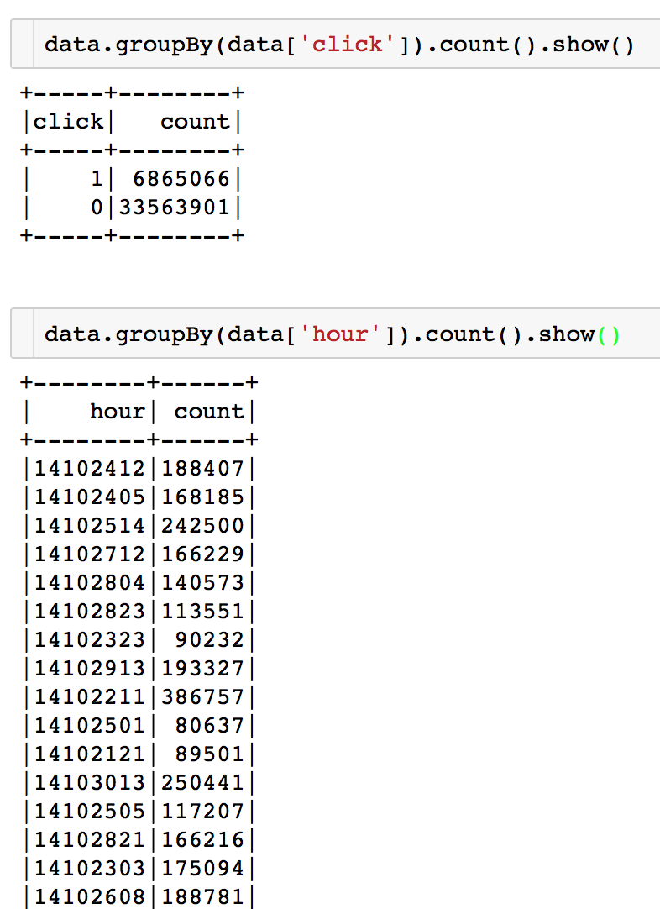
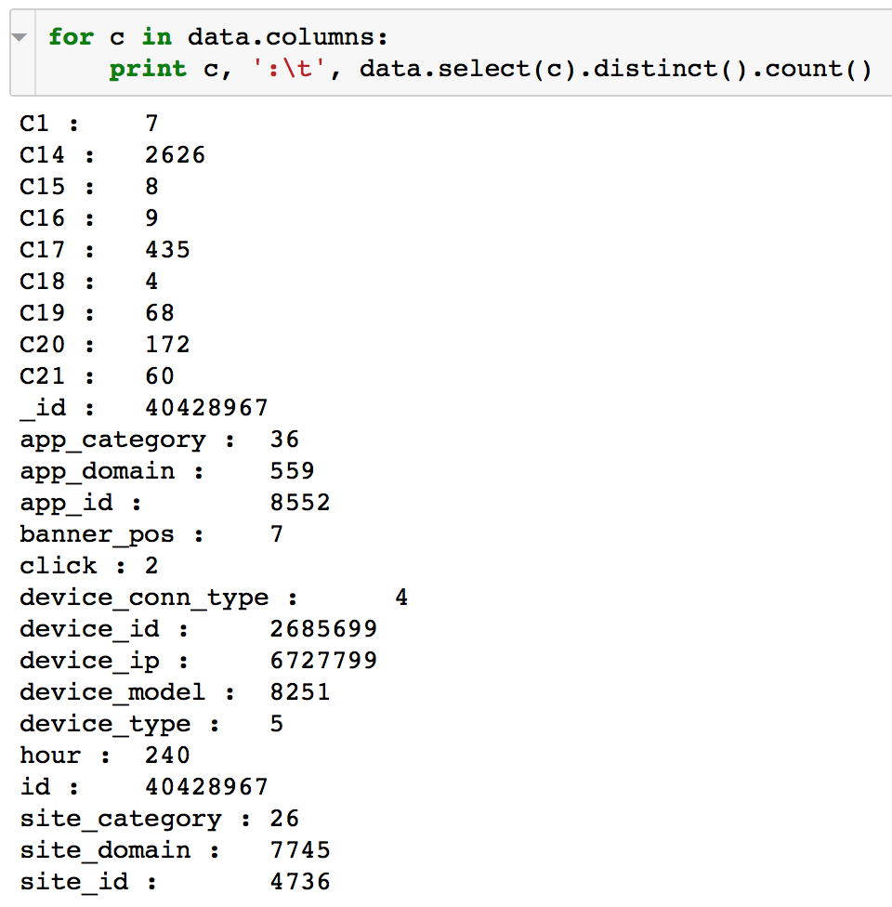
Query with Spark SQL
Notes:
23 features → 14 features (excluding label – click)

Slide 10
Feature engineering
1. Removed features with more than 100 categories
Removed 12 features
2. Extracted features and made new categories
hour → hour, day of week feature
device_ip

Slide 11
Feature engineering
hour is in yymmddhh format
extract the last 2 digits hh from hour column:
data = data.withColumn(‘hh’, (F.col(‘hour’) % 100))
eg: 14102100 → 00
extract the day of week info from hour column
data = data.withColumn(‘dow’, (F.col(‘hour’) / 100 - 141019).cast(‘int’) % 7)
eg: 14102100 → 2
device_ip is in hexadecimal format
extract the first 3 digits of ip address
data = data.withColumn(‘ip’, F.conv(data.device_ip.substr(0,2),16,10).alias('deci').cast('int'))
eg: e8275b8f → e8 → 232

Slide 12
Preprocess for ml model
Convert string type columns into integer type with
StringIndexer()
One-hot-encode categorical data with
OneHotEncoder()
Convert selected features into vector that can be taken by SparkML model with
VectorAssembler()
Split the processed data into training set (80%) and test set (20%) with
.randomSplit()

Slide 13
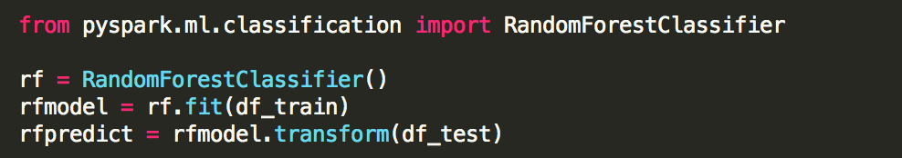
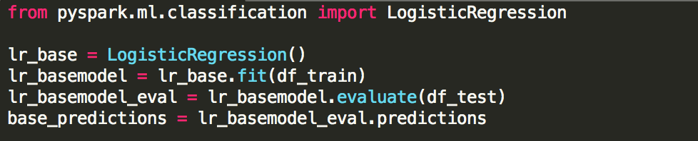
Fit prediction models
1. Random Forest Classifier
Parameters: maxDepth=5, maxBins=32, numTrees=20
2. Logistic Regression
Default parameters

Slide 14
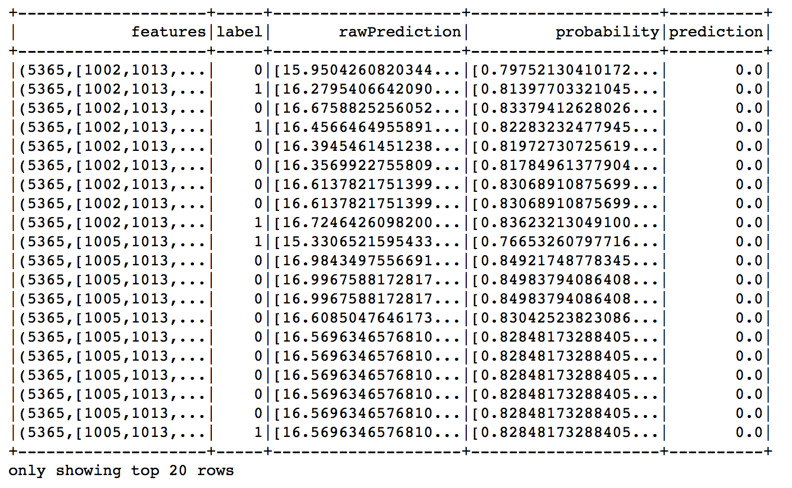
Predictions and evaluation
1. Random Forest
Accuracy = 0.8300
F1 = 0.7533
AUC = 0.6482
2. Logistic Regression
Accuracy = 0.8306
F1 = 0.7591
AUC = 0.6830
Logistic Regression is much simpler and easier to interpret, but similar results.
Reasonable model, could be better.

Slide 15
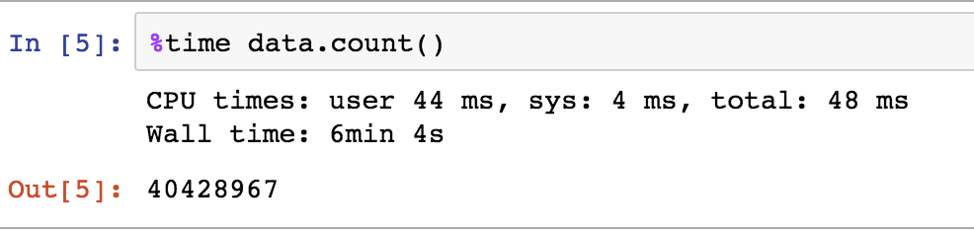
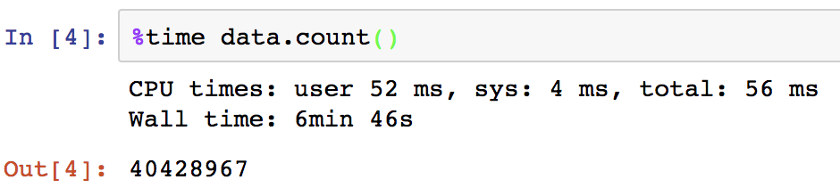
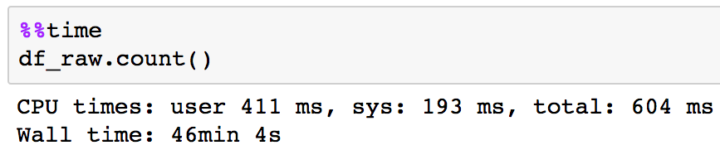
Lesson learned
Choose machines wisely
Configuration | Price | Computation Speed
EMR: 3 instances, m4.2xlarge vCPU: 8 Mem(GiB): 32 | $0.36 per hour | Wall time: 6min 4s
EMR: 3 instances, m4.xlarge vCPU: 4 Mem(GiB): 16 | $0.18 per hour | Wall time: 6min 46s
MacBook pro: processor: 2.7GHz Intel Core i5 Memory: 8 GB 1867 MHz DDR3 | $0.09 per hour (estimated) | Wall time: 46min 4s
Notes:
*But, our ML model crashed on smaller EMR machine and the local machine

Slide 16
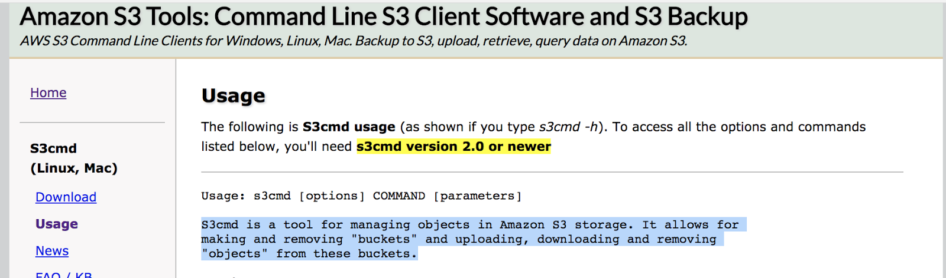
Lesson learned
A useful tool for managing objects in S3 storage: s3cmd
Notes:
- Use s3cmd to import data from S3 storage without copying the whole file to disk. Can save space on disk, especially when dataset is large.
- s3cmd allows us to manipulate data in terminal, has other features you can use (check it out)

Slide 17
Thank You!

